Slide 1

R code tutorial:
Assessing the effect of Vitamin D exposure on Fn biofilm formation
Leticia Testa
May 2nd, 2024

Slide 2
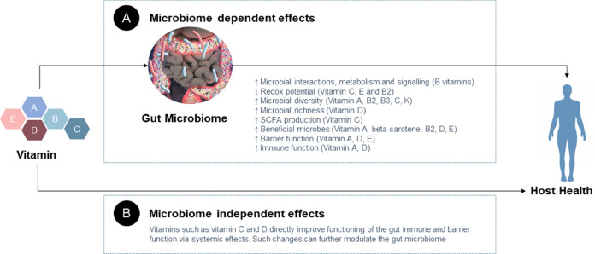
Studies have shown the correlation between vitamin D and microbial population stability
Vitamin D is an essential nutrient and hormone
Saputo S, Faustoferri RC, Quivey RG Jr,. Antimicrob Agents Chemother. 2017 Dec 21;62(1):e01675-17.

Slide 3
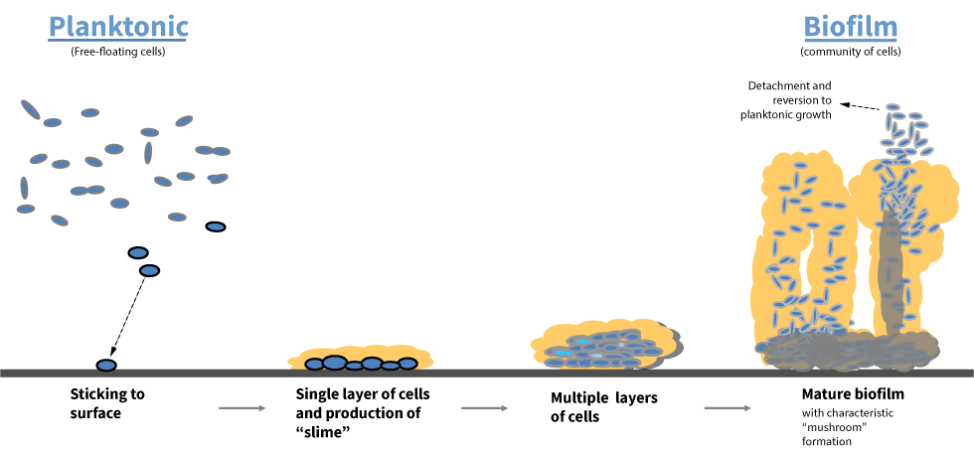
We have also been heavily interested in bacterial biofilm and how biofilm positive tumors are correlated with increase disease progression.
Free floating cells
Saputo S, Faustoferri RC, Quivey RG Jr,. Antimicrob Agents Chemother. 2017 Dec 21;62(1):e01675-17.

Slide 4
Research question:
Does Vitamin D change the ability of a CRC-associated F. nucleatum strain to form biofilm?

Slide 5
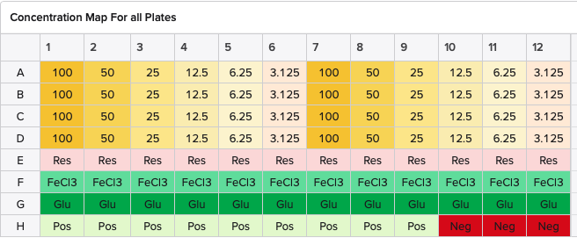
Treatments
Reagents | Treatment Concentration | Starting Concentrations
Vitamin D | 100 ng/uL (200 uM) | -
Resveratrol | 100 ug/mL | 25 mg/mL
Glucose | 1% | 10%
FeCl3 | 200 uM | 1 M
Vitamin D

Slide 6
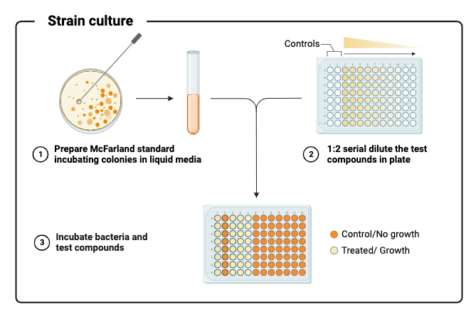
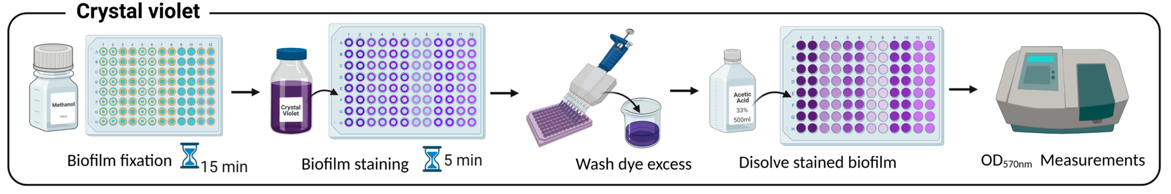
Setup
Concentration range for Vitamin D:
3.125 ng/uL – 100 ng/uL

Slide 7


Slide 8
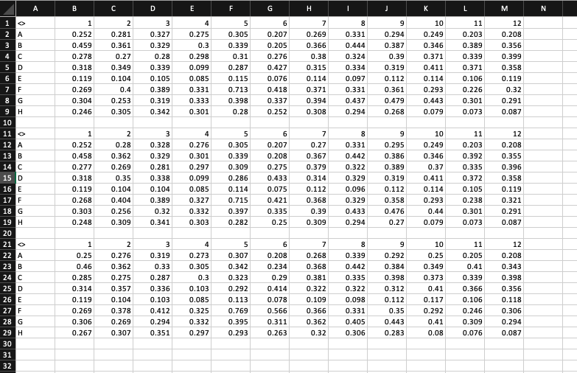

Excel analysis
Raw data:
Three technical
replicates

Slide 9
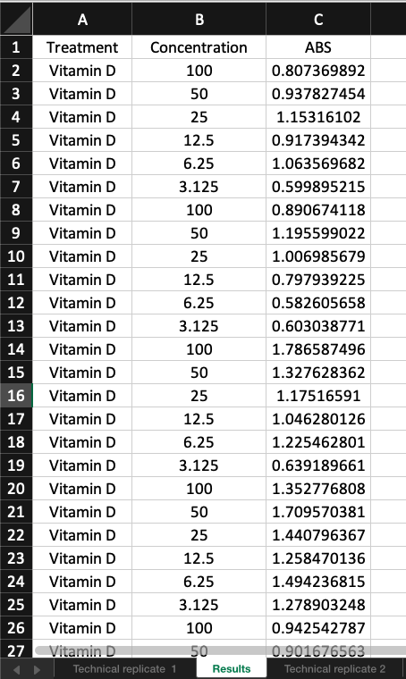
Excel analysis
Separate data into columns:
Treatment
Concentration
ABS
94 columns

Slide 10
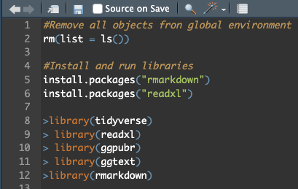
R code
Clean up environment
Install and upload libraries
Used to read excel files
Package that creates “wrappers” for much of ggplot2’s core functionality.
Extension of ggplot
Useful for integration of code and text, and it’s easy to customize

Slide 11
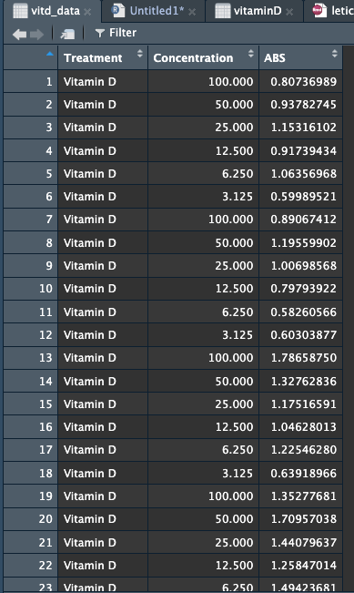
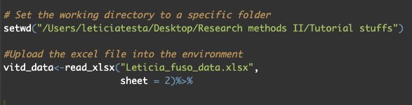
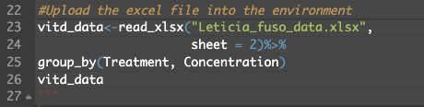
R code
Setup my working directory:

Slide 12
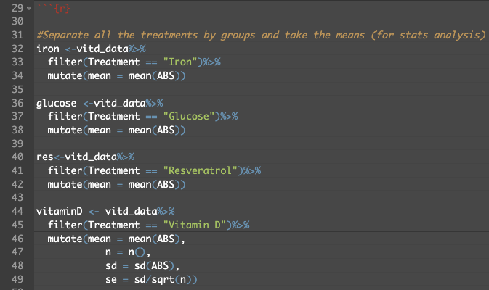
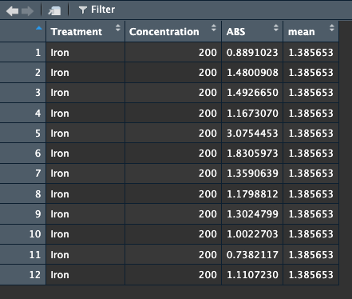
R code
Separate data into treatment columns:
Mutate – this function is part of ‘dplyr’ package and is used to add new variables (columns) to a data frame.

Slide 13
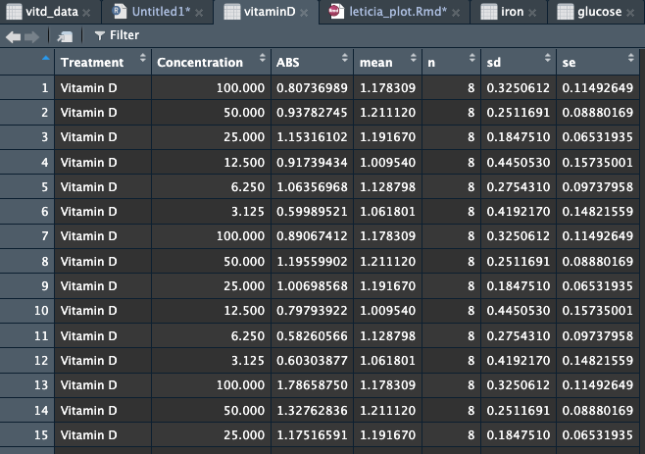
R code
Now I want pool all this data together and do some stats:

Slide 14
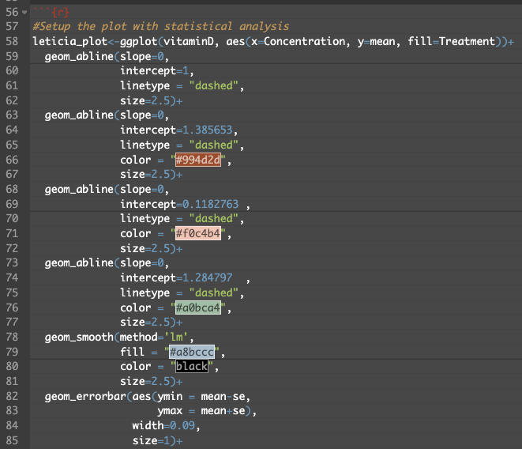
R code
Now that I have my data setup with statistical analysis, I need to plot:
geom_abline – function to add a straight line with specified slope and intercept (I am using a dashed line)
geom_smooth – adds a smooth line to a plot (linear trend)
geom_errorbar – adds error bars to a plot

Slide 15
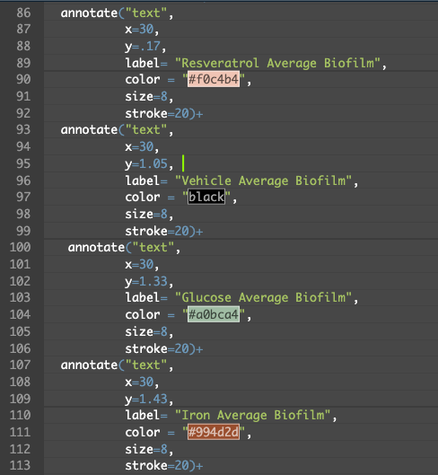
R code
Using annotate to label my lines:

Slide 16
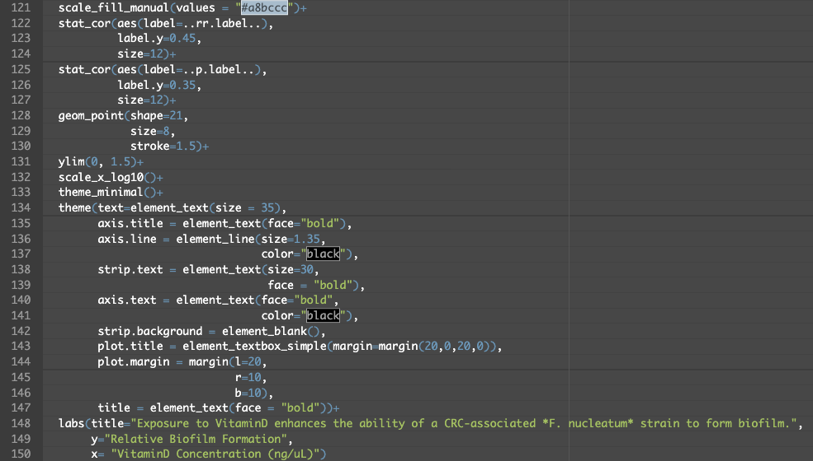
R code
Final touchups:
‘Stat_cor’ – function in ggplot2 used to compute correlation coefficients
‘geom_point’ – function used to create a scatterplot

Slide 17
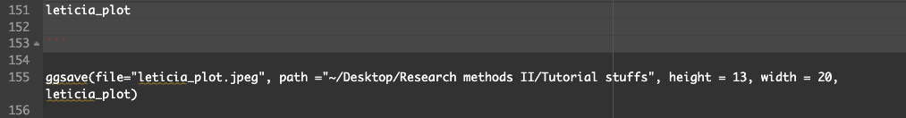
R code
‘Stat_cor’ – function in ggplot2 used to compute correlation coefficients
‘geom_point’ – function used to create a scatterplot

Slide 18
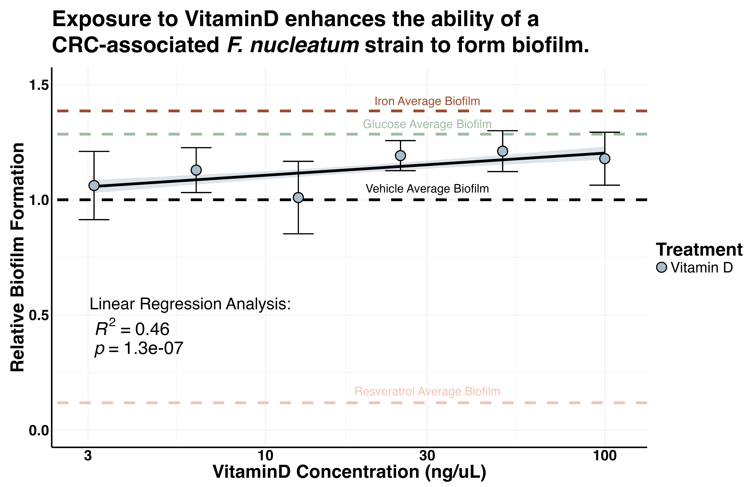
Final product

Slide 19
References
[1] Xie, Yihui. 2015. Dynamic Documents with R and Knitr. 2nd ed. Boca Raton, Florida: Chapman; Hall/CRC.
[2] Giorgi FM, Ceraolo C, Mercatelli D. The R Language: An Engine for Bioinformatics and Data Science. Life (Basel). 2022 Apr 27;12(5):648. doi: 10.3390/life12050648.
[3] Ito K, Murphy D. Application of ggplot2 to Pharmacometric Graphics. CPT Pharmacometrics Syst Pharmacol. 2013 Oct 16;2(10):e79. doi: 10.1038/psp.2013.56.
[4] Drăghici S. Statistics and data analysis for microarrays using R and Bioconductor, 2nd Edition. CRC Press; 2012.
[5] Stiglic G, Watson R, Cilar L. R you ready? Using the R programme for statistical analysis and graphics. Res Nurs Health. 2019 Dec;42(6):494-499. doi: 10.1002/nur.21990.
[6] Gelfond J, Goros M, Hernandez B, Bokov A. A System for an Accountable Data Analysis Process in R. R J. 2018 Jul;10(1):6-21. Epub 2018 May 15.

